Slide 1
Hinduism

Slide 2

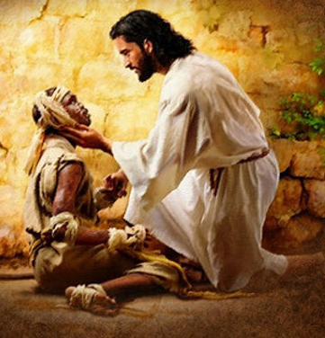
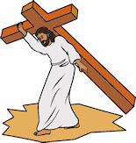
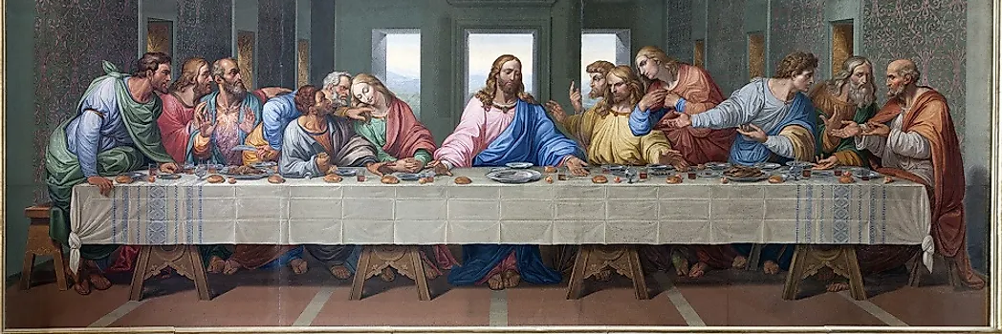
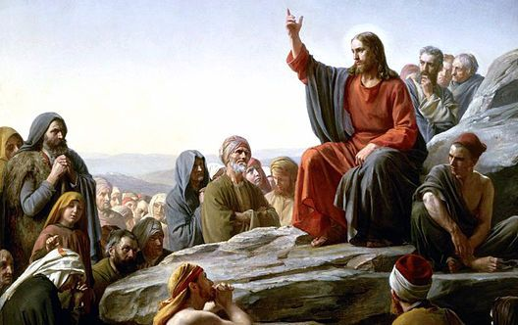
In the last Lesson
N/A
2. A few lessons ago
N/A
4. Before that
What different roles did Jesus have?
3. In the last unit
Who were the disciples to Jesus?
Notes:
Use MTP, Knowledge concepts and skills progression
History, Geography, RE, PSHE
4. Could have chosen more knowledge but focussing on ‘sources’ (Skill) and ‘Society’ (Concept)
I think you can probably find something for every quadrant for every lesson,especially if you combine knowledge facts, concepts and skills. In the example you have in the slides, the 'before that' sections would have perhaps been something taught in KS1? For example, 'What was the same/different when your grandparents went to school?' This would support the concept of 'Society' and revisits previous learning.
** Subject Leaders will collate and review year group previous learning slides

Slide 3



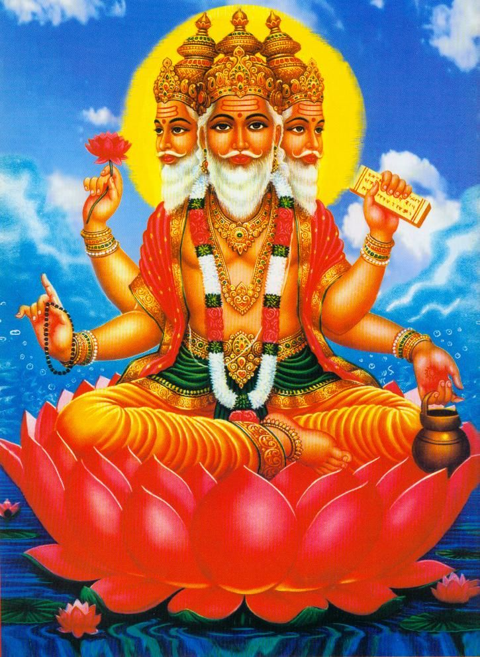
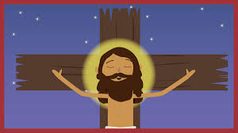
In the last Lesson
What roles do we play?
2. A few lessons ago
N/a
3. In the last unit
What role did Jesus play in the easter story?
4. Before that
Who do Hindus believe in?
Notes:
Use MTP, Knowledge concepts and skills progression
History, Geography, RE, PSHE
4. Could have chosen more knowledge but focussing on ‘sources’ (Skill) and ‘Society’ (Concept)
I think you can probably find something for every quadrant for every lesson,especially if you combine knowledge facts, concepts and skills. In the example you have in the slides, the 'before that' sections would have perhaps been something taught in KS1? For example, 'What was the same/different when your grandparents went to school?' This would support the concept of 'Society' and revisits previous learning.
** Subject Leaders will collate and review year group previous learning slides

Slide 4

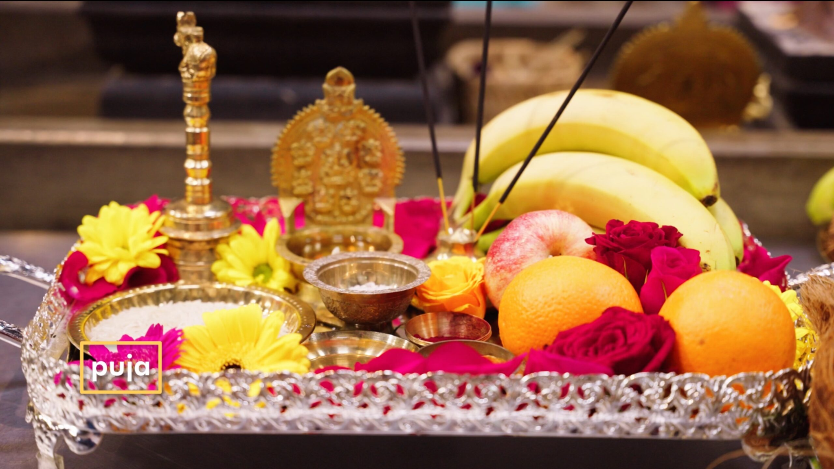
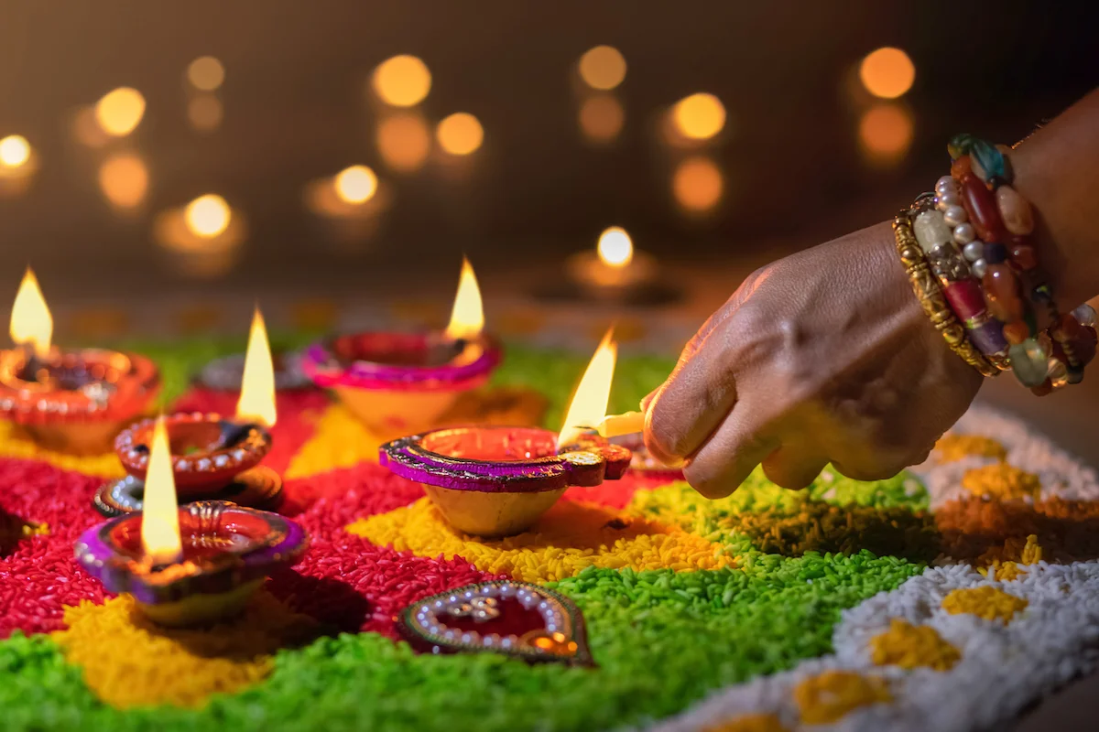
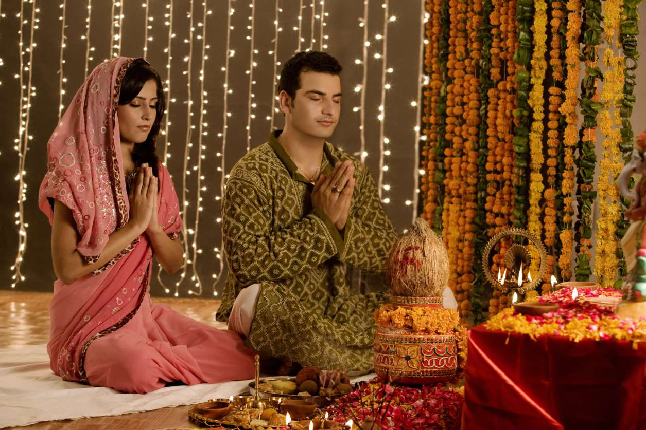
In the last Lesson
Who do Hindus pray to?
2. A few lessons ago
Who is Brahman to Hindus?
3. In the last unit
What is a Puja?
4. Before that
How do Hindus show their appreciation to their God?
Notes:
4) Sun or lamp
4. Could have chosen more knowledge but focussing on ‘sources’ (Skill) and ‘Society’ (Concept)

Slide 5
In the last Lesson
2. A few lessons ago
What is Brahman?
3. In the last unit
N/A
4. Before that
Notes:
4) Sun or lamp
4. Could have chosen more knowledge but focussing on ‘sources’ (Skill) and ‘Society’ (Concept)

Slide 6
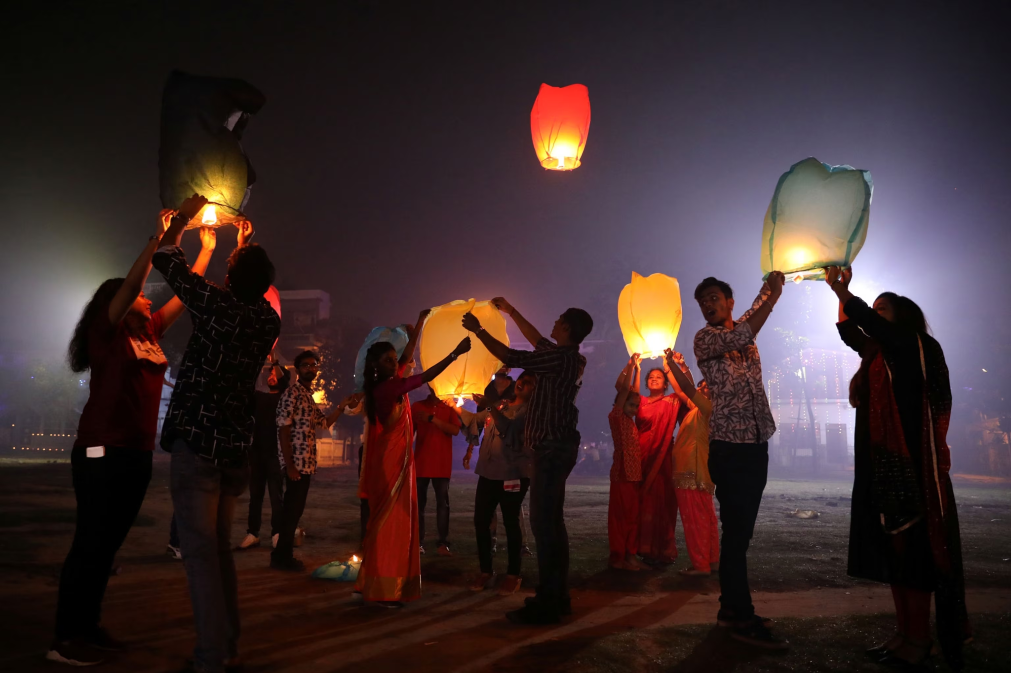
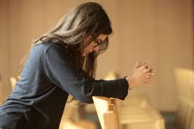
In the last Lesson
What god to Hindu’s believe in?
2. A few lessons ago
N/A
3. In the last unit
How do Christians show commitment to Jesus?
4. Before that
How do Hindu’s celebrate?
Notes:
4) Sun or lamp
4. Could have chosen more knowledge but focussing on ‘sources’ (Skill) and ‘Society’ (Concept)

Slide 7
In the last Lesson
2. A few lessons ago
3. In the last unit
4. Before that
Notes:
4) Sun or lamp
4. Could have chosen more knowledge but focussing on ‘sources’ (Skill) and ‘Society’ (Concept)

