Slide 1
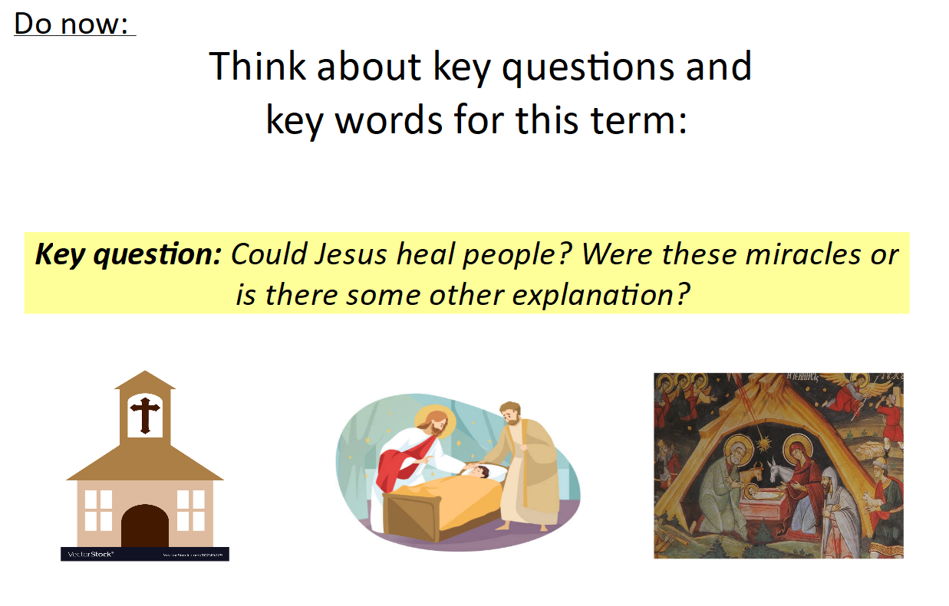

Slide 2
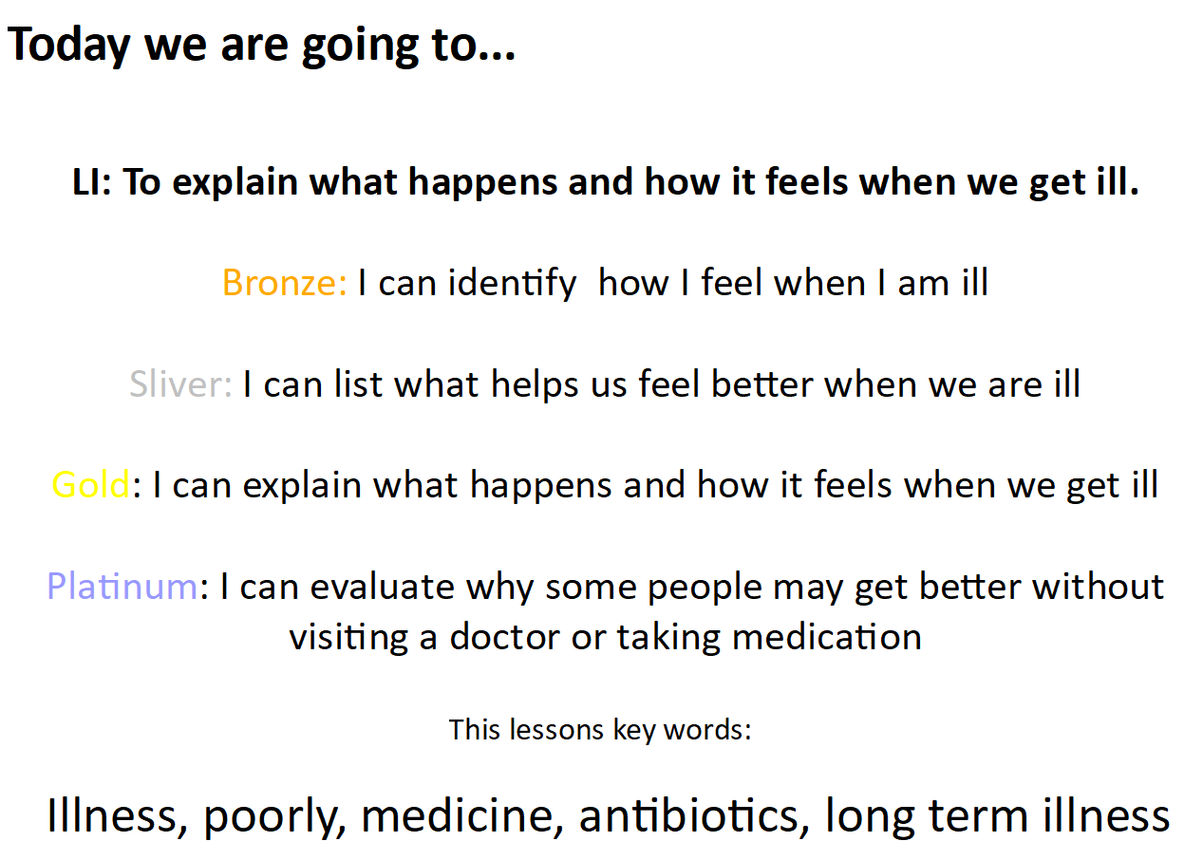

Slide 3
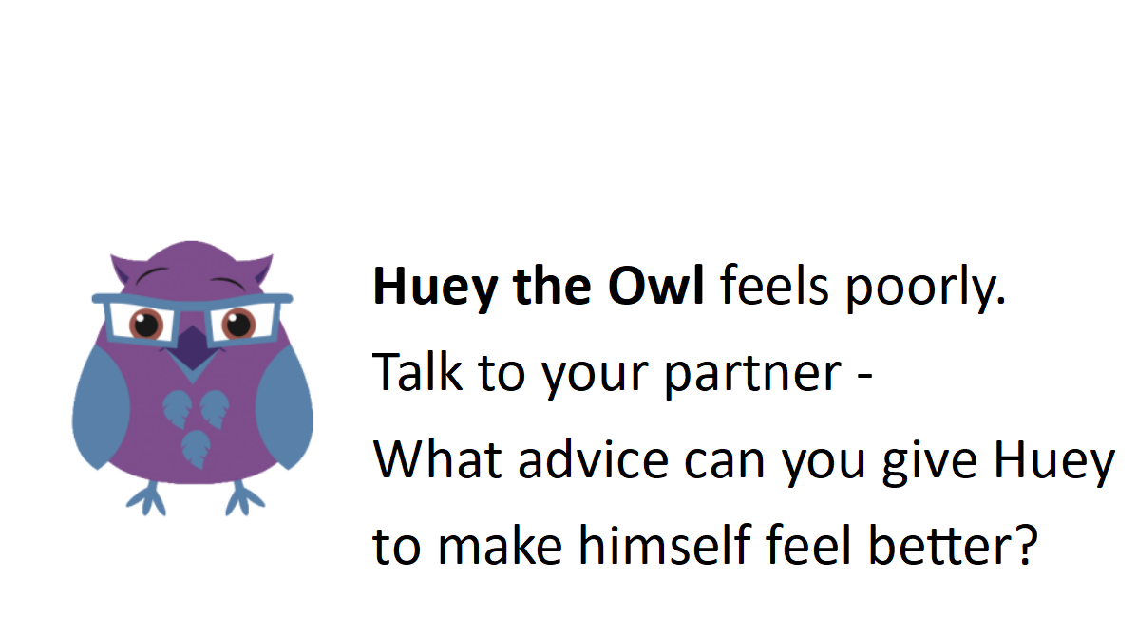

Slide 4
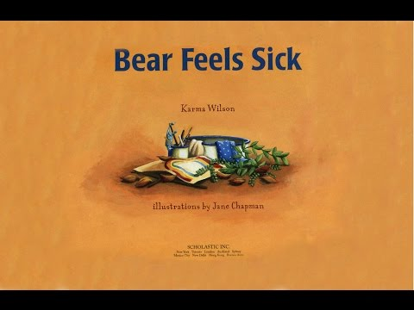

Slide 5
TTYP: Discuss what happened to Bear and how he felt better.
How do our bodies get better when we are poorly?
If you are poorly what do you do?
Who looks after you?
How do you get better?
Do you go to the doctor/need medicine?
Sometimes we can help ourselves - how?
Does frame of mind help?

Slide 6
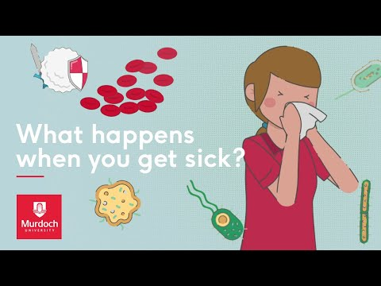

Slide 7
Are all illnesses always flu or cold?
What about other long term illnesses or injuries people could have?
Are these illnesses always easy to cure?

Slide 8

You and your partner will have large paper and pencils.
Work as a group to record what happens and how it feels when we get poorly/sick.

